Slide 1
ServSafe Ch. 2
Forms of contamination

Slide 2
How contamination happens
From person to person
Through sneezing or vomiting on to food contact surfaces
From touching dirty food-contact surfaces then touching food

Slide 3
Biological Contamination
Harmful microorganisms are called pathogens
Some pathogens make you sick when you eat them, others produce poisins or toxins

Slide 4
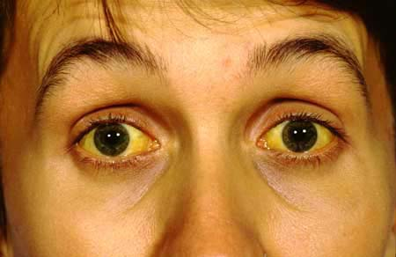
Symptoms of foodborne illness
Diarrhea
Vomiting
Fever
Nausea
Cramps
jaundice

Slide 5
Bacteria
Bacteria can be found almost anywhere, some are helpful and some cause illness
Can’t see, smell, or taste bacteria
Bacteria doubles every 20 minutes!! (from 0 to more than 1 billion in 10 hours)
MOST IMPORTANT WAY TO PREVENT BACTERIA IS TO CONTROL TIME/TEMPERATURE ABUSE

Slide 6
What bacteria need to grow
FOOD: TCS food
ACIDITY: grow best in food with little or no acidity
TEMPERATURE: bacteria grow rapidly between 41 F and 135 F DANGER ZONE
TIME: need time to grow
OXYGEN: some bacteria need oxygen, some do not
MOISTURE: bacteria grow well in food with high levels of moisture

Slide 7
3 worst bacteria that cause food borne illness:
SALMONELLA Typhi
SHIGELLA spp.
ENTEROHEMORRHAGIC and SHIGA TOXIN producing E-Choli
Food handlers diagnosed with ANY of these can NEVER work in a foodservice operation when they are sick

Slide 8
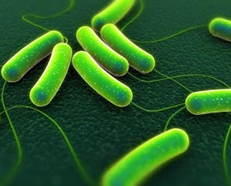
SALMONELLA TYPHI
SOURCE | FOOD LINKED WITH BACTERIA | PREVENTION MEASURES
Samonella Typhi lives only in humans. People with typhoid fever carry the bacteria in their blood stream and intestinal tract. | Ready to Eat Beverages | EXCLUDE FROM WORK WASH HANDS COOK FOOD TO MINIMUM INTERNAL TEMPS.

Slide 9
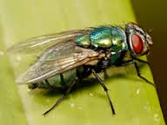
SHIGELLA spp.
SOURCE | FOOD LINKED WITH BACTERIA | PREVENTION MEASURES
Shigella spp. Is found in the feces of humans with the illness. Can be transferred from contaminated water or food. FLIES can transfer from feces to food. | Foods that are easily contaminated from a person’s hands: salads containing TCS foods (potato, tuna, shrimp, macaroni, and chicken) Food that has made contact with contaminated water, such as produce. | EXCLUDE WORKERS DIAGNOSED EXCLUDE WORKERS WITH DIARRHEA Wash hands Control flies

Slide 10
SHIGA TOXIN-producing and ENTEROHEMORRHAGIC (E-CHOLI)
SOURCE | FOOD LINKED WITH BACTERIA | PREVENTION MEASURES
Found in the intestines of cattle. Bacteria can contaminate meat during slaughtering. Once eaten it produces the toxins in a person’s intestines. | Ground beef Contaminated produce | EXCLUDE workers with diarrhea Cook food, expecially ground beef to min. internal temp. Purchase produce from approved suppliers Prevent cross-contamination from raw meat and ready to eat food

Slide 11
VIRUSES
Viruses are carried by humans and animals
Viruses need a living host to GROW
While viruses do not grow in food, it can be transferred to food and continue to be infectious
People can get viruses from any contaminated source
NOROVIRUS is one of the leading causes of foodborne illness
Viruses are NOT destroyed by cooking

Slide 12
HEPATITIS A
SOURCE | FOOD LINKED WITH VIRUS | PREVENTION MEASURES
It is found in the feces of people that are contaminated. The virus can be transferred to food when infected food handlers touch it with fingers that have feces on them. Feces=poop Cooking does NOT destroy HepA | Ready to eat food Shellfish from contaminated water | EXCLUDE workers who have been diagnosed, or who have jaundice from work WASH HANDS Avoid bare-hand contact with food Purchase shellfish from approved suppliers

Slide 14
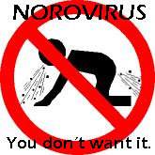
NOROVIRUS
SOURCE | FOOD LINKED WITH VIRUS | PREVENTION MEASURES
Norovirus is often transferred to food when infected food handlers touch food or equipment with fingers that have feces on them. Extremely contagious. | Ready to eat food Shellfish from contaminated water | EXCLUDE staff who have been diagnosed from work. EXCLUDE anyone who has diarrhea or is vomiting from work. WASH HANDS Avoid bare hand contact with food Purchase shellfish from approved supplier

Slide 15
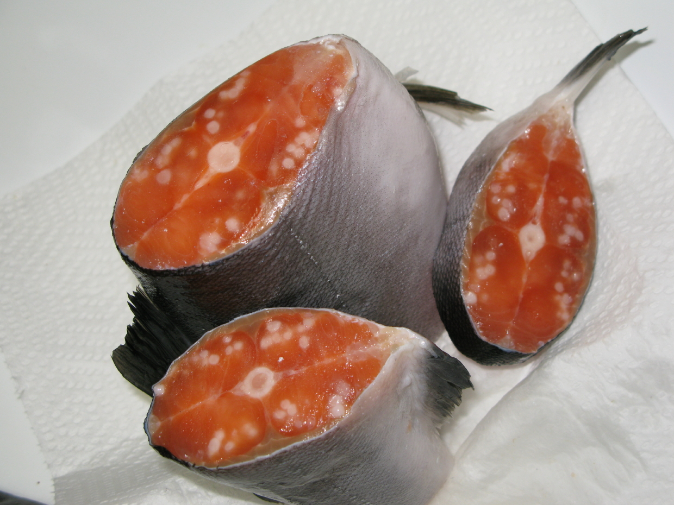
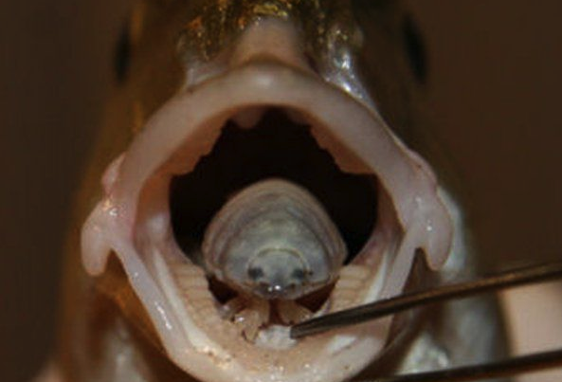
PARASITES
LOCATION | SOURCES | PREVENTION
Require a living host to live and reproduce | Seafood, wild game, produce un contaminated water | Purchase from approved suppliers Cook food to minimum internal temperatures

Slide 16
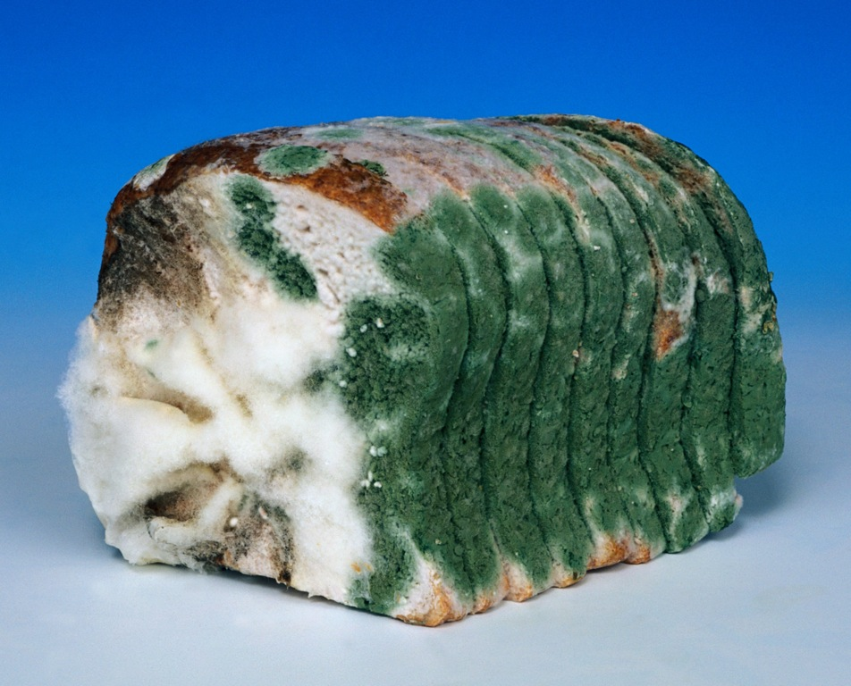
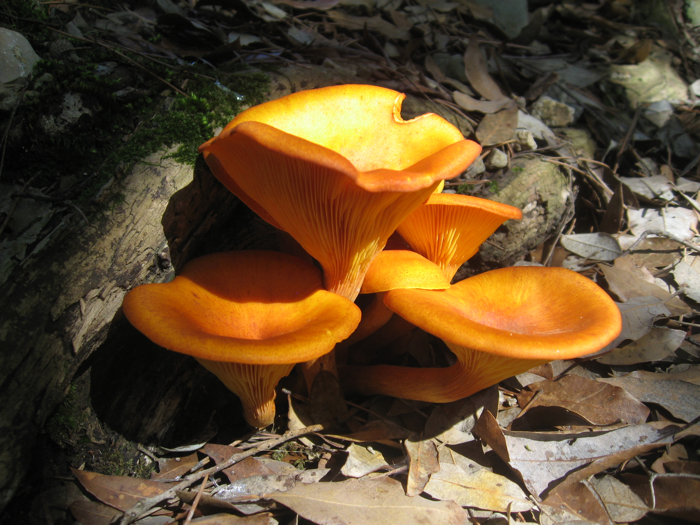
FUNGI
Yeasts
Molds
Mushrooms
PRODUCE TOXINS!!

Slide 17
BIOLOGICAL TOXINS
ORIGINS | SYMPTOMS | PREVENTION
Some toxins are naturally associated with certain plants, mushrooms, and seafood. Toxins are a natural part of some fish. Other toxins happen when fish has been time-temperature abused. | Diarrhea Vomiting Tingling Reversal of hot and cold Numbness Redness of face, shortness of breath | CANNOT be destroyed by cooking or freezing Purchase from approved supplier Control time and temperature

Slide 18
BIOLOGICAL TOXINS CONTINUED
TOXIN | FOOD LINKED WITH | PREVENTION
HISTAMINE | Tuna, Mahi Mahi | PURCHASE FROM APPROVED SUPPLIERS
CIGUATERA | Barracuda, Snapper, Grouper
SHELLFISH TOXIN | Shellfish that eat contaminated marine algae

Slide 19
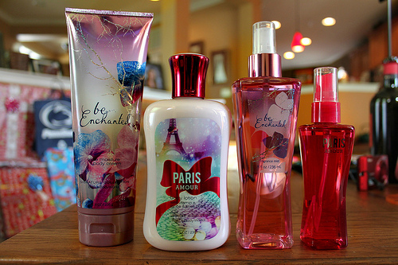
CHEMICAL CONTAMINANTS
SOURCES | SYMPTOMS | PREVENTION
Sanitizers, pesticides, beauty products (body spray, lotion) Toxic Metals: copper, lead, zinc (when used with acidic food) | Vomiting Diarrhea | Store chemicals AWAY from food NEVER store above/near food Make sure all are labeled Keep MSDS current Follow directions when disposing of chemicals

Slide 20
PHYSICAL CONTAMINANTS
SOURCES | SYMPTOMS | PREVENTION
Metal shavings from cans, wood, glass, pieces of plastic, staples, fruit pits, and bones | Choking Cuts | Closely inspect food you receive

Slide 21
DELIBERATE CONTAMINATION OF FOOD
Terrorists, angry employees, competitors
Make sure to:
Inspect all deliveries
Lock prep and storage areas
Store chemicals AWAY from food
Identify all visitors check for badges

Slide 22
RESPONDING TO FOODBORNE ILLNESS OUTBREAK
IF AN OUTBREAK OCCURS:
Ask the person their information, when they first began feeling sick, and which food was eaten
Notify authorities
Document
Identify staff
Review procedures

Slide 23
ALLERGY SYMPTOMS
A FOOD ALLERGEN IS A PROTEIN IN A FOOD THAT PEOPLE ARE SENSITIVE TO:
SYMPTOMS INCLUDE
Nausea
Wheezing
Hives/rash
Swelling
Vomiting
cramps

Slide 24
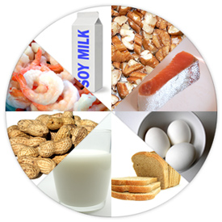
COMMON FOOD ALLERGENS: SPEWDFS
Milk
Eggs
Fish
Shellfish
Wheat
Soy
Peanuts
Tree nuts

Slide 25
PREVENTING ALLERGIC REACTION
Describe dishes
Identifying ingredients
Suggest simpler food items
Hand deliver food to the customer
Cook food in separate fryers
Prevent cross contact with surfaces that have touched the food allergen

Slide 26
How to avoid cross contact
WASH, RINSE, and SANITIZE all cookware and equipment between uses
Wash your hands and change gloves
Use separate fryers
Prep food separately for people with allergies
Label all allergens on food that is packaged

