Slide 2
Providing Safe Food
Objectives:
Recognize the importance of food safety
Understand how food becomes unsafe
Identify TCS food
Recognize the risk factors for foodborne illness
Understand important prevention measures for keeping food safe
1-2
Notes:
Instructor Notes
Discuss the topic objectives with the class.

Slide 3
Challenges to Food Safety
A foodborne illness is a disease transmitted to people through food.
An illness is considered an outbreak when:
Two or more people have the same symptoms after eating the same food
An investigation is conducted by state and local regulatory authorities
The outbreak is confirmed by laboratory analysis
1-3

Slide 4
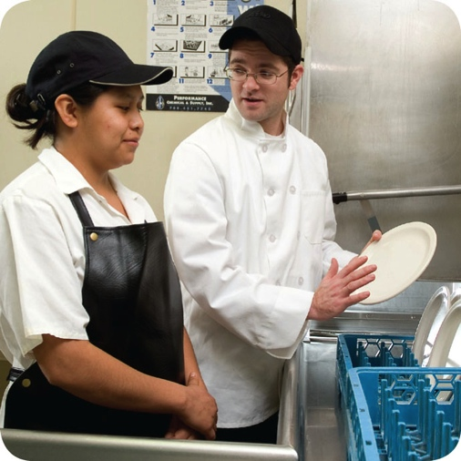
Challenges to Food Safety
Challenges include:
Time and money
Language and culture
Literacy and education
Pathogens
Unapproved suppliers
High-risk customers
Staff turnover
1-4
Notes:
Instructor Notes
Pressure to work quickly can make it hard to take the time to follow food safety practices.
Your staff may speak a different language than you do, which can make it difficult to communicate. Cultural differences can also influence how food handlers view food safety.
Staff often have different levels of education, making it more challenging to teach them food safety.
Illness-causing microorganisms are more frequently found on food that once was considered safe.
Food that is received from suppliers that are not practicing food safety can cause a foodborne-illness outbreak.
The number of customers at high risk for getting a foodborne illness is increasing. An example of this is the growing elderly population.
Training new staff leaves less time for food safety training.
The ServSafe program will provide the tools needed to overcome the challenges in managing a good food safety program.

Slide 5
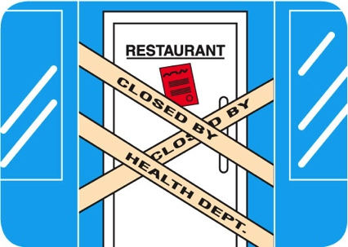
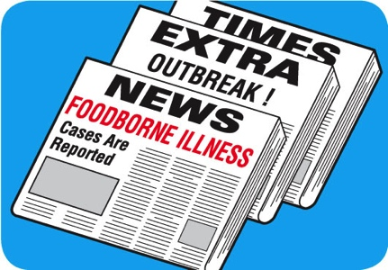
Costs of Foodborne Illness
Costs of a foodborne illness to an operation:
Loss of customers and sales
Loss of reputation
Negative media exposure
Lowered staff morale
1-5
Notes:
Instructor Notes
National Restaurant Association figures show that one foodborne-illness outbreak can cost an operation thousands of dollars and even result in closure.
Most important, victims of foodborne illness may experience lost work, medical costs, long-term disability, and even death.

Slide 6
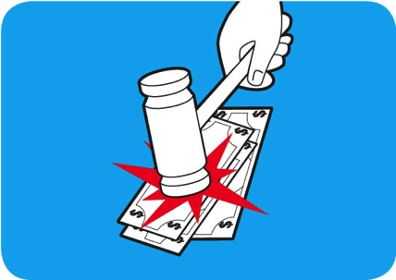
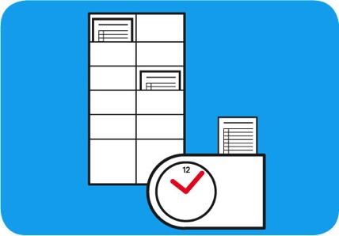
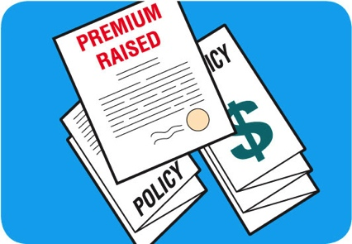
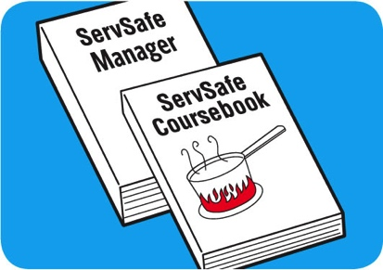
Costs of Foodborne Illness
Costs of a foodborne illness to an operation:
Lawsuits and legal fees
Staff missing work
Increased insurance premiums
Staff retraining
1-6
Notes:
Instructor Notes
National Restaurant Association figures show that one foodborne-illness outbreak can cost an operation thousands of dollars and even result in closure.
Most important, victims of foodborne illness may experience lost work, medical costs, long-term disability, and even death.

Slide 7
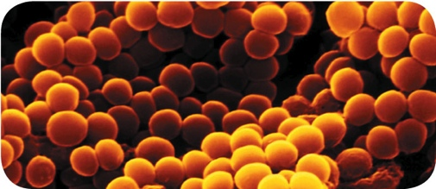
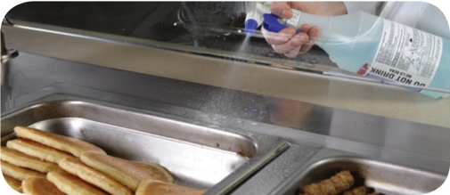
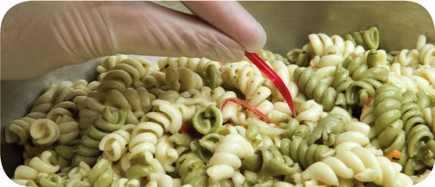
How Foodborne Illnesses Occur
Unsafe food is the result of contamination:
Biological
Chemical
Physical
1-7
Notes:
Instructor Notes
Unsafe food is usually the result of contamination, which is the presence of harmful substances in the food.
Contaminants can come from pathogens, chemicals, or physical objects. They might also come from certain unsafe practices in your operation.
Each of the contaminants listed above is a danger to food safety. But biological contaminants are responsible for most foodborne illness.

Slide 8
Contaminants
Biological contaminants:
Bacteria
Viruses
Parasites
Fungi
1-8
Notes:
Instructor Notes
Pathogens are the greatest threat to food safety. They include certain viruses, parasites, fungi, and bacteria. Some plants, mushrooms, and seafood that carry harmful toxins (poisons) are also included in this group.

Slide 9
Contaminants
Chemical contaminants:
Cleaners
Sanitizers
Polishes
1-9
Notes:
Instructor Notes
Foodservice chemicals can contaminate food if they are used incorrectly.

Slide 10
Contaminants
Physical hazards:
Metal shavings
Staples
Bandages
Glass
Dirt
Natural objects (e.g., fish bones in a fillet)
1-10

Slide 11
How Food Becomes Unsafe
Five risk factors for foodborne illness:
Purchasing food from unsafe sources
Failing to cook food correctly
Holding food at incorrect temperatures
Using contaminated equipment
Practicing poor personal hygiene
1-11
Notes:
Instructor Notes
If food is not handled correctly, it can become unsafe. These are the five most common food-handling mistakes, or risk factors, that can cause foodborne illness.

Slide 12
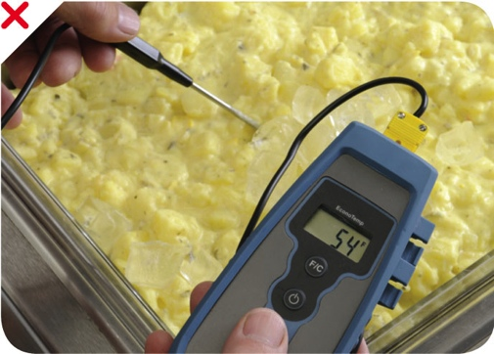
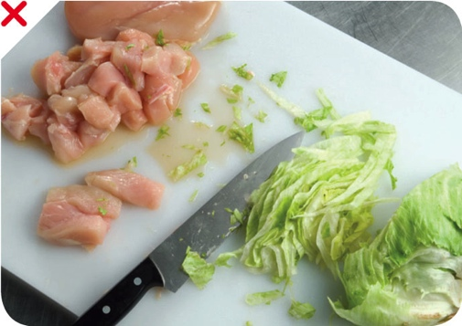
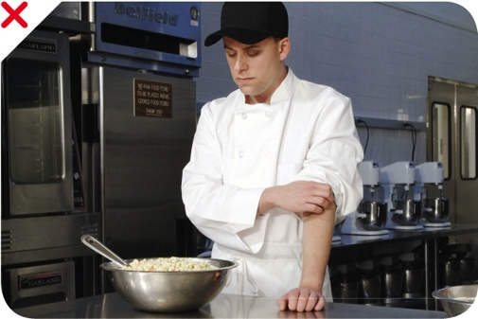
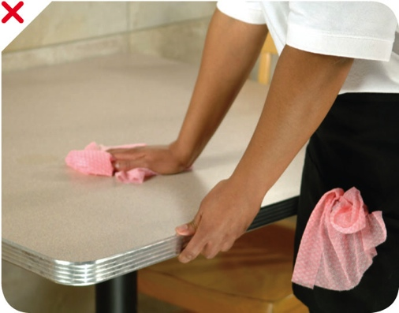
How Food Becomes Unsafe
Time-temperature abuse
Cross-contamination
Poor personal hygiene
Poor cleaning and sanitizing
1-12
Notes:
Instructor Notes
Except for purchasing food from unsafe sources, each risk factor for foodborne illness is related to four main factors: time-temperature abuse, cross-contamination, poor personal hygiene, and poor cleaning and sanitizing.

Slide 13
How Food Becomes Unsafe
Time-temperature abuse:
When food has stayed too long at temperatures good for pathogen growth
1-13

Slide 14
How Food Becomes Unsafe
Food has been time-temperature abused when:
It has not been held or stored at correct temperatures
It is not cooked or reheated enough to kill pathogens
It is not cooled correctly
Pg 1.5 SSF 6e
Pg 1.5 SSF 6e
Pg 1.5 SSF 6e
1-14

Slide 15
How Food Becomes Unsafe
Cross-contamination:
When pathogens are transferred from one surface or food to another
Pg 1.5 SSF 6e
1-15

Slide 16
How Food Becomes Unsafe
Cross-contamination can cause a foodborne illness when:
Contaminated ingredients are added to food that receives no further cooking
Ready-to-eat food touches contaminated surfaces
A food handler touches contaminated food and then touches ready-to-eat food
Contaminated cleaning cloths touch food-contact surfaces
Pg 1.5 SSF 6e
1-16

Slide 17
How Food Becomes Unsafe
Poor personal hygiene can cause a foodborne illness when food handlers:
Fail to wash their hands correctly after using the restroom
Cough or sneeze on food
Touch or scratch wounds and then touch food
Work while sick
Pg 1.5 SSF 6e
1-17

Slide 18
How Food Becomes Unsafe
Poor cleaning and sanitizing:
Equipment and utensils are not washed, rinsed, and sanitized between uses
Food contact surfaces are wiped clean instead of being washed rinsed, and sanitized
Wiping cloths are not stored in a sanitizer solution between uses
Sanitizer solution was not prepared correctly
Pg 1.5 SSF 6e
1-18
Notes:
Instructor Notes:

Slide 19
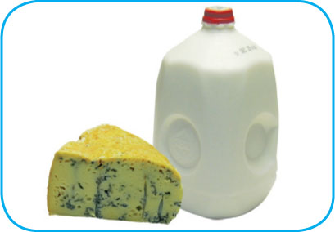
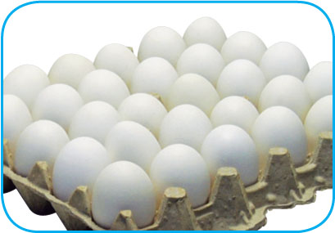
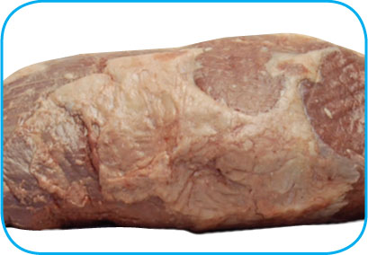
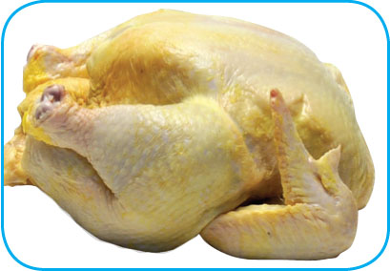
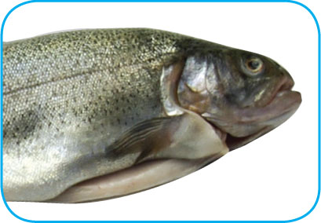
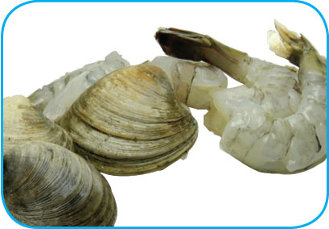
Food Most Likely to Become Unsafe
TCS food:
1-19
Notes:
Instructor Notes
The list of TCS food includes the following:
Milk and dairy products
Shell eggs (except those treated to eliminate nontyphoidal Salmonella)
Meat: beef, pork, and lamb
Poultry
Fish
Shellfish and crustaceans

Slide 20
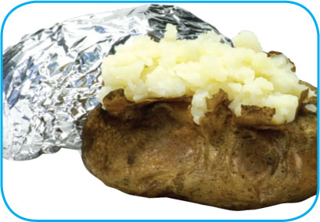
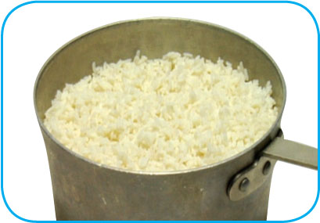
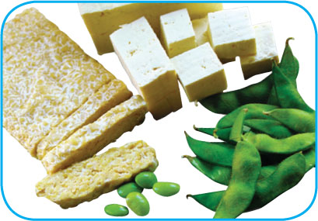
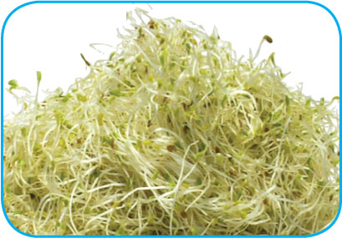
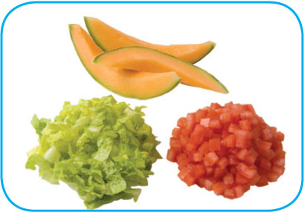
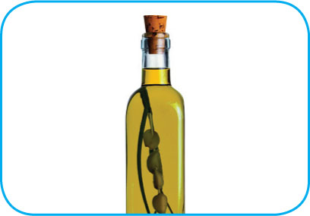
Food Most Likely to Become Unsafe
TCS food:
1-20
Notes:
Instructor Notes
The list of TCS food includes the following:
Baked potatoes
Heat-treated plant food, such as cooked rice, beans, and vegetables
Tofu or other soy protein; synthetic ingredients, such as textured soy protein in meat alternatives
Sprouts and sprout seeds
Sliced melons; cut tomatoes; cut leafy greens
Untreated garlic-and-oil mixtures

Slide 21
Ready-to-Eat Food
Ready-to-eat food is food that can be eaten without further:
Preparation
Washing
Cooking
Ready-to-eat food includes:
Cooked food
Washed fruit and vegetables
Deli meat
Bakery items
Sugar, spices, and seasonings
1-21
Notes:
Instructor Notes
Like TCS food, ready-to-eat food also needs careful handling to prevent contamination.

Slide 22
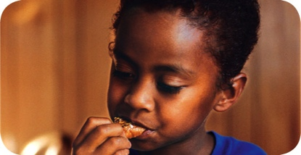
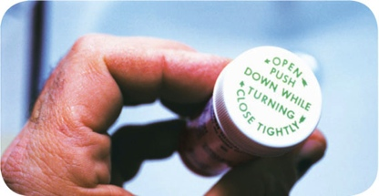
Populations at High Risk for Foodborne Illnesses
These people have a higher risk of getting a foodborne illness:
Elderly people
Preschool-age children
People with compromised immune systems
1-22
Notes:
Instructor Notes
Elderly people are at high risk because their immune systems have weakened with age.
Very young children are at high risk because they have not built up strong immune systems.
People with compromised immune systems include:
People with cancer or on chemotherapy
People with HIV/AIDS
Transplant recipients
People taking certain medications

Slide 23
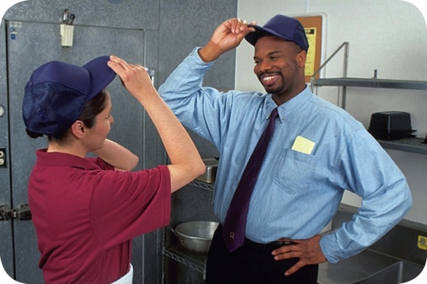
Keeping Food Safe
Focus on these measures:
Controlling time and temperature
Preventing cross-contamination
Practicing personal hygiene
Purchasing from approved, reputable suppliers
Cleaning and sanitizing
1-23
Notes:
Instructor Notes
Set up standard operating procedures that focus on these areas. The ServSafe program will show you how to design these procedures.

Slide 24
Keeping Food Safe
Training and monitoring:
Train staff to follow food safety procedures
Provide initial and ongoing training
Provide all staff with general food safety knowledge
Provide job specific food safety training
Retrain staff regularly
Monitor staff to make sure they are following procedures
Document training
1-24
Notes:
Instructor Notes
Managers must set up standard operating procedures that focus on the measures listed on the slide. Then they must train their staff on these procedures and monitor them to make sure the procedures are followed.

Slide 25
Keeping Food Safe
Government agencies:
The Food and Drug Administration (FDA)
U.S. Department of Agriculture (USDA)
Centers for Disease Control and Prevention (CDC)
U.S. Public Health Service (PHS)
State and local regulatory authorities
1-25
Notes:
Instructor Notes
The Food and Drug Administration (FDA) inspects all food except meat, poultry, and eggs. The agency also regulates food transported across state lines. In addition, the agency issues the FDA Food Code, which provides recommendations for food safety regulations.
The U.S. Department of Agriculture (USDA) regulates and inspects meat, poultry, and eggs. It also regulates food that crosses state boundaries or involves more than one state.
Agencies such as the Centers for Disease Control and Prevention (CDC) and the U. S. Public Health Service (PHS) conduct research into the causes of foodborne-illness outbreaks.
State and local regulatory authorities write or adopt code that regulates retail and foodservice operations.

Slide 27
You Can Prevent Contamination
Objectives:
Biological, chemical, and physical contaminants and how to prevent them
How to prevent the deliberate contamination of food
How to respond to a foodborne-illness outbreak
Common food allergens and how to prevent reactions to them
2-2
Notes:
Instructor Notes
Discuss the topic objectives with the class.

Slide 28
How Contamination Happens
Contaminants come from a variety of places:
Animals we use for food
Air, contaminated water, and dirt
People
Deliberately
Accidentally
2-3
Notes:
Instructor Notes
Contamination comes from a variety of places.
Contaminants can cause foodborne illness or result in physical injury.
Contaminants are found in the animals we use for food, the air, water, dirt; and they occur naturally in food, such as bones in fish.
Food can be contaminated on purpose.
Most food is contaminated accidently.
Examples of accidental contamination include: food handlers who don’t wash their hands after using the restroom, and then contaminate food and surfaces with feces from their fingers; and food handlers who pass contaminants through illness.

Slide 29
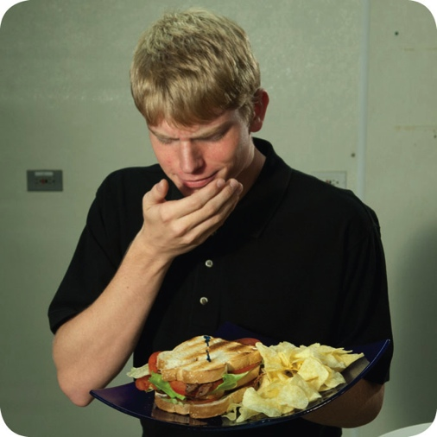
How Contamination Happens
People can contaminate food when:
They don’t wash their hands after using the restroom
They are in contact with a person who is sick
They sneeze or vomit onto food or food contact surfaces
They touch dirty food-contact surfaces and equipment and then touch food
2-4
Notes:
Instructor Notes
Food handlers who don’t wash their hands after using the restroom may contaminate food and surfaces with feces from their fingers. Once the food that the food handler touched is eaten, a foodborne illness may result. This is called the fecal-oral route of contamination.

Slide 30
Biological Contamination
Microorganism:
Small, living organism that can be seen only with a microscope
Pathogen:
Harmful microorganism
Make people sick when eaten or produce toxins that cause illness
Toxin:
Poison
2-5
Notes:
Instructor Notes
Biological contamination occurs when harmful microorganisms, referred to as pathogens, contaminate food.

Slide 31
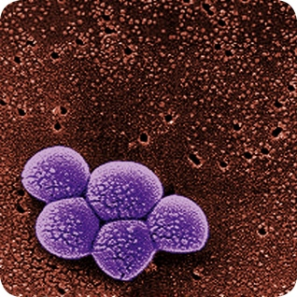
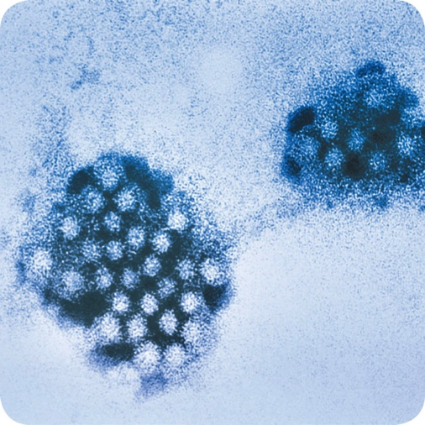
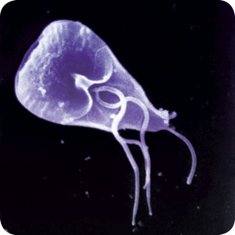
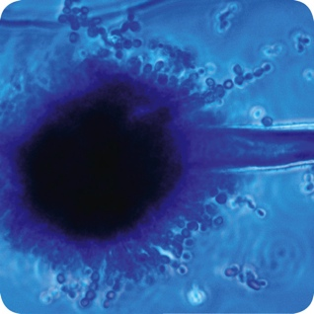
Biological Contamination
Four types of pathogens can contaminate food and cause foodborne illness:
Bacteria
Viruses
Parasites
Fungi
2-6
Notes:
Instructor Notes
Each type of pathogen will be discussed in more detail throughout the presentation.

Slide 32
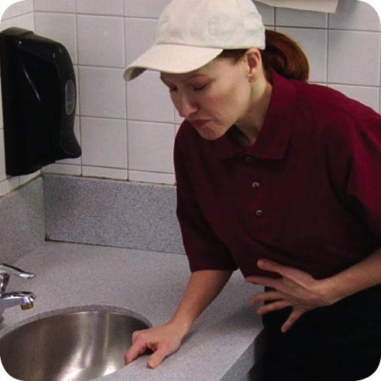
Biological Contamination
Common symptoms of foodborne illness:
Diarrhea
Vomiting
Fever
Nausea
Abdominal cramps
Jaundice (yellowing of skin and eyes)
Onset times:
Depend on the type of foodborne illness
Can range from 30 minutes to six weeks
2-7
Notes:
Instructor Notes
The symptoms of a foodborne illness vary depending on which illness a person has. But most victims of foodborne illness share some common symptoms.
Not every person who is sick from a foodborne illness will have all of these symptoms. Nor are the symptoms of a foodborne illness limited to this list.
How quickly foodborne-illness symptoms appear in a person is known as the onset time of the illness. Onset times depend on the type of foodborne illness a person has. They can range from 30 minutes to as long as six weeks. How severe the illness is can also vary, from mild diarrhea to death.

Slide 33
The “Big Six” Pathogens
Food handlers diagnosed with illnesses from the “Big Six” pathogens cannot work in a foodservice operation while they are sick.
Shigella spp.
Salmonella Typhi
Nontyphoidal Salmonella (NTS)
Shiga toxin-producing Escherichia coli (STEC), also known as E. coli
Hepatitis A
Norovirus
2-8
Notes:
Instructor Notes
According to the Food and Drug Administration (FDA), there are over 40 different kinds of bacteria, viruses, parasites, and molds that can occur in food and cause a foodborne illness. Of these, six have been singled out by the FDA. These have been dubbed the “Big Six” because they are highly contagious and can cause severe illness. They include:
Shigella spp.
Salmonella Typhi
Nontyphoidal Salmonella (NTS)
Shiga toxin-producing Escherichia coli (STEC), also known as E. coli
Hepatitis A
Norovirus
These pathogens are often found in very high numbers in an infected person’s feces and can be transferred to food easily. A person does not have
to eat much of the pathogen in order to get sick, and that illness is often severe. For this reason, food handlers diagnosed with illnesses from these
pathogens cannot work in a foodservice operation while they are sick.

Slide 34
Bacteria: Basic Characteristics
Location:
Found almost everywhere
Detection:
Cannot be seen, smelled, or tasted
Growth:
Will grow rapidly if FAT TOM conditions are correct
Prevention:
Control time and temperature
2-9
Notes:
Instructor Notes
Bacteria live in our bodies. Some types of bacteria keep us healthy, while others cause illness.
The most important way to prevent bacteria from causing foodborne illness is to control time and temperature.

Slide 35
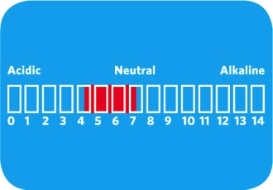
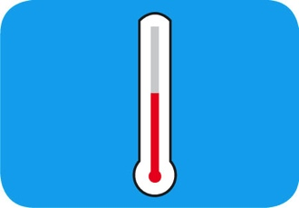
What Bacteria Need to Grow
F
Food
A
Acidity
T
Temperature
T
Time
O
Oxygen
M
Moisture
2-10
Notes:
Instructor Notes
Bacteria need six conditions to grow. You can remember these conditions by thinking of the words FAT TOM.

Slide 36
What Bacteria Need to Grow
Food:
Most bacteria need nutrients to survive
TCS food supports the growth of bacteria better than other types of food
F
Food
2-11

Slide 37
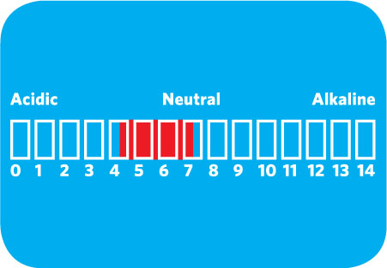
What Bacteria Need to Grow
Acidity:
Bacteria grow best in food that contains little or no acid
A
Acidity
2-12
Notes:
Instructor Notes
The pH scale ranges from 0 to 14.0.
A value of 0 is highly acidic, while a value of 14 is highly alkaline.
A pH of 7 is neutral.
Bacteria grow best in food that is neutral to slightly acidic

Slide 38
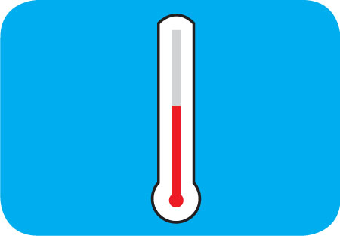
What Bacteria Need to Grow
Temperature:
Bacteria grow rapidly between 41˚F and 135˚F (5˚C and 57˚C)
This range is known as the temperature danger zone
Bacteria growth is limited when food is held above or below the temperature danger zone
T
Temperature
2-13
Notes:
Instructor Notes
Bacteria grow even more rapidly from 70° F to 125° F (21°C to 52°C).

Slide 39
What Bacteria Need to Grow
Time:
Bacteria need time to grow
The more time bacteria spend in the temperature danger zone, the greater chance they have to grow to unsafe levels.
T
Time
2-14

Slide 40
What Bacteria Need to Grow
Oxygen:
Some bacteria need oxygen to grow, while others grow when oxygen isn’t there
O
Oxygen
2-15

Slide 41
What Bacteria Need to Grow
Moisture:
Bacteria grow well in food with high levels of moisture
aw = water activity; the amount of moisture available in food for bacterial growth
aw scale ranges from 0.0 to 1.0
Water has a water activity of 1.0
M
Moisture
2-16
Notes:
Instructor Notes
The amount of moisture available in food is called water activity (aw). The aw scale ranges rom 0.0 to 1.0.
The higher the value, the more available moisture in the food.

Slide 42
Control FAT TOM
The conditions you can control:
Temperature
Keep TCS food out of the temperature danger zone
Time
Limit how long TCS food spends in the temperature danger zone
2-17
Notes:
Instructor Notes
Temperature and time are the two important conditions for growth that can be controlled in the operation.

Slide 43
Major Bacteria That Cause Foodborne Illness
The FDA has identified four types of bacteria that cause severe illness and are highly contagious:
Salmonella Typhi
Nontyphoidal Salmonella
Shigella spp.
Shiga toxin-producing Escherichia coli
2-18
Notes:
Instructor Notes
Food handlers with illnesses from these bacteria can NEVER work in a foodservice operation while they are sick.
These four bacteria are included in the FDA’s “Big Six” pathogens.

Slide 44
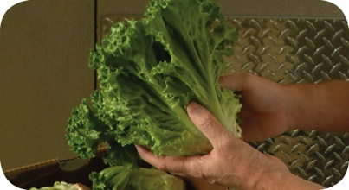
Major Bacteria That Cause Foodborne Illness
Bacteria: Salmonella Typhi (SAL-me-NEL-uh TI-fee)
Source: People
Food Linked with the Bacteria | Prevention Measures
Ready-to-eat food Beverages | Exclude food handlers diagnosed with an illness caused by Salmonella Typhi from the operation
 | Wash hands
 | Cook food to minimum internal temperatures
2-19
Notes:
Instructor Notes
Salmonella Typhi lives only in humans.
People with typhoid fever carry the bacteria in their bloodstream and intestinal tract.
Eating only a small amount of these bacteria can make a person sick.
The severity of symptoms depends on the health of the person and the amount of bacteria eaten. The bacteria are often in a person’s feces for weeks after symptoms have ended.

Slide 45
Major Bacteria That Cause Foodborne Illness
Bacteria: Nontyphoidal Salmonella (SAL-me-NEL-uh)
Source: Farm animals, People
Food Linked with the Bacteria | Prevention Measures
Poultry and eggs Meat Milk and dairy products Produce | Cook poultry and eggs to minimum internal temperatures
 | Prevent cross-contamination between poultry and ready-to-eat food
 | Keep food handlers who are vomiting or have diarrhea and have been diagnosed with an illness from nontyphoidal Salmonella out of the operation
2-20
Notes:
Instructor Notes
Many farm animals carry nontyphoidal Salmonella naturally.
Eating only a small amount of these bacteria can make a person sick.
The severity of symptoms depends on the health of the person and the amount of bacteria eaten. The bacteria are often in a person’s feces for weeks after symptoms have ended.

Slide 46
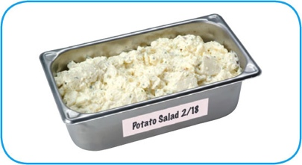
Major Bacteria That Cause Foodborne Illness
Bacteria: Shigella spp. (shi-GEL-uh)
Source: Human feces
Food Linked with the Bacteria | Prevention Measures
Food easily contaminated by hands, such as salads containing TCS food (potato, tuna, shrimp, macaroni, chicken) | Exclude food handlers who have diarrhea and have been diagnosed with an illness caused by Shigella spp. from the operation Exclude food handlers who have diarrhea from the operation
Food that has made contact with contaminated water, such as produce | Wash hands
 | Control flies inside and outside the operation
2-21
Notes:
Instructor Notes
Shigella spp. is found in the feces of humans with the illness.
Most illnesses occur when people eat or drink contaminated food or water.
Flies can also transfer the bacteria from feces to food.
Eating only a small amount of these bacteria can make a person sick.
High levels of the bacteria are often in a person’s feces for weeks after symptoms have ended.

Slide 47
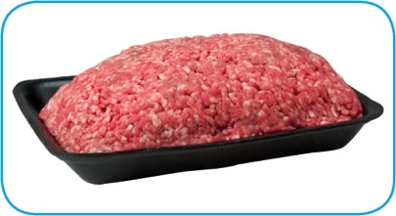
Major Bacteria That Cause Foodborne Illness
Bacteria: Shiga toxin-producing Escherichia coli (ess-chur-EE-kee-UH-KO-LI), also known as E. coli
Source: Intestines of cattle; infected people
Food Linked with the Bacteria | Prevention Measures
Ground beef (raw and undercooked) Contaminated produce | Exclude food handlers who have diarrhea and have been diagnosed with a disease from the bacteria Cook food, especially ground beef, to minimum internal temperatures
 | Purchase produce from approved, reputable suppliers
 | Prevent cross-contamination between raw meat and ready-to-eat food
2-22
Notes:
Instructor Notes
Shiga toxin-producing E. coli can be found in the intestines of cattle.
It is also found in infected people.
The bacteria can contaminate meat during slaughtering.
Eating only a small amount of the bacteria can make a person sick.
Once eaten, it produces toxins in the intestines, which cause the illness.
The bacteria are often in a person’s feces for weeks after symptoms have ended.

Slide 48
Viruses: Basic Characteristics
Location:
Carried by human beings and animals
Require a living host to grow
Do not grow in food
Can be transferred through food and remain infectious in food
Sources:
Food, water, or any contaminated surface
Typically occur through fecal-oral routes
2-23
Notes:
Instructor Notes
Viruses are the leading cause of foodborne illness.

Slide 49
Viruses: Basic Characteristics
Destruction:
Not destroyed by normal cooking temperatures
Good personal hygiene must be practiced when handling food and food-contact surfaces
Quick removal and cleanup of vomit is important
2-24

Slide 50
Major Viruses that Cause Foodborne Illnesses
The FDA has identified two viruses that are highly contagious and can cause severe illness:
Hepatitis A
Norovirus
Food handlers diagnosed with an illness from hepatitis A or Norovirus must not work in an operation while they are sick.
2-25
Notes:
Instructor Notes
These two viruses are included in the FDA’s “Big Six” pathogens.

Slide 51
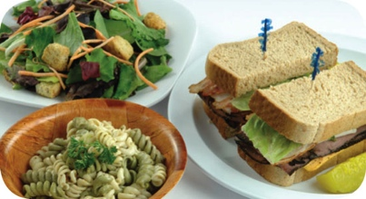
Major Viruses That Cause Foodborne Illness
Virus: Hepatitis A (HEP-a-TI-tiss)
Source: Human feces
Food Linked with the Virus | Prevention Measures
Ready-to-eat food Shellfish from contaminated water | Exclude staff who have been diagnosed with hepatitis A from the operation.
 | Exclude staff who have jaundice for seven days or less from the operation.
 | Wash hands.
 | Avoid bare-hand contact with ready-to-eat food.
 | Purchase shellfish from approved, reputable suppliers.
2-26
Notes:
Instructor Notes
Hepatitis A is mainly found in the feces of people infected with it.
The virus can contaminate water and many types of food.
It is commonly linked with ready-to-eat food. However, it has also been linked with shellfish from contaminated water.
The virus is often transferred to food when infected food handlers touch food or equipment with fingers that have feces on them.
Eating only a small amount of the virus can make a person sick.
An infected person may not show symptoms for weeks but can be very infectious.
Cooking does not destroy hepatitis A.

Slide 52
Major Viruses That Cause Foodborne Illness
Virus: Norovirus (NOR-o-VI-rus)
Source: Human feces
Food Linked with the Virus | Prevention Measures
Ready-to-eat food Shellfish from contaminated water | Exclude staff who are vomiting or have diarrhea and have been diagnosed with Norovirus from the operation.
 | Wash hands.
 | Avoid bare-hand contact with ready-to-eat food.
 | Purchase shellfish from approved, reputable suppliers.
2-27
Notes:
Instructor Notes
Like hepatitis A, Norovirus is commonly linked with ready-to-eat food.
It has also been linked with contaminated water.
Norovirus is often transferred to food when infected food handlers touch food or equipment with fingers that have feces on them.
Eating only a small amount of Norovirus can make a person sick. It is also very contagious.
People become contagious within a few hours after eating it.
The virus is often in a person’s feces for days after symptoms have ended.

Slide 53
Parasites: Basic characteristics
Location:
Require a host to live and reproduce
Source:
Seafood, wild game, and food processed with contaminated water, such as produce
2-28

Slide 54
Parasites: Basic characteristics
Prevention:
Purchase food from approved, reputable suppliers
Cook food to required minimum internal temperatures
Fish that will be served raw or undercooked, must be frozen correctly by the manufacturer
2-29
Notes:
Instructor Notes
The most important way to prevent foodborne illnesses from parasites is to purchase food from approved, reputable suppliers.
Cooking food to required minimum internal temperatures is also important.
Make sure that fish that will be served raw or undercooked has been correctly frozen by the manufacturer.

Slide 55
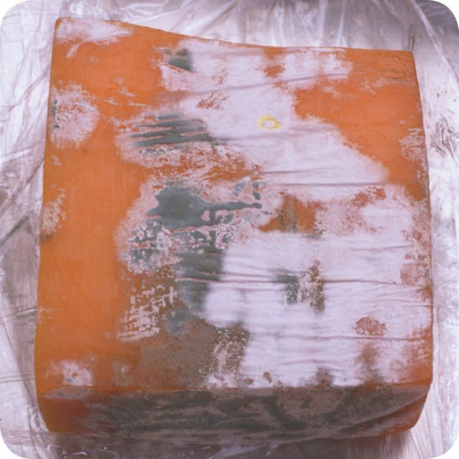
Fungi: Basic Characteristics
Yeasts, molds, and mushrooms:
Some molds and mushrooms produce toxins
Throw out moldy food, unless mold is a natural part of the food
Purchase mushrooms from approved, reputable suppliers
2-30
Notes:
Instructor Notes
Fungi include yeasts, molds, and mushrooms.

Slide 56
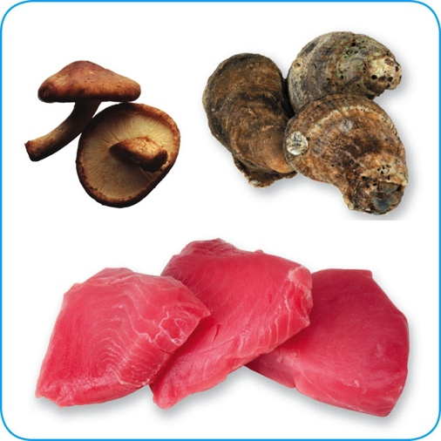
Biological Toxins
Origin:
Naturally occur in certain plants, mushrooms, and seafood
Seafood toxins:
Produced by pathogens found on certain fish
Tuna, bonito, mahimahi
Histamine produced when fish is time-temperature abused
Occur in certain fish that eat smaller fish that have consumed the toxin
Barracuda, snapper, grouper, amberjack
Ciguatera toxin is an example
2-31
Notes:
Instructor Notes
Some toxins are naturally associated with certain plants, mushrooms, and seafood. Toxins are a natural part of some fish.
Other toxins, such as histamine, are made by pathogens on the fish when it is time-temperature abused. This can occur in tuna, bonito, mackerel, and mahimahi.
Some fish become contaminated when they eat smaller fish that have eaten a toxin. One of these toxins is the ciguatera toxin. It can be found in barracuda, snapper, grouper, and amberjack. Shellfish, such as oysters, can be contaminated when they eat marine algae that have a toxin.

Slide 57
Biological Toxins
Illness:
Symptoms and onset times vary with illness
People will experience illness within minutes
General symptoms:
Diarrhea or vomiting
Neurological symptoms
Tingling in extremities
Reversal of hot and cold sensations
Flushing of the face and/or hives
Difficulty breathing
Heart palpitations
2-32
Notes:
Instructor Notes
Toxins cannot be destroyed by cooking or freezing. The most important way to prevent a foodborne illness is to purchase plants, mushrooms, and seafood from approved, reputable suppliers. It is also important to control time and temperature when handling raw fish.

Slide 58
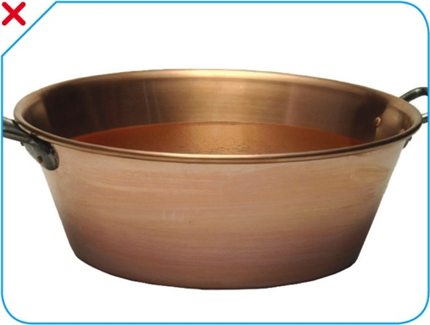
Chemical Contaminants
Sources:
Certain types of kitchenware and equipment (items made from pewter, copper, zinc, and some types of painted pottery)
Cleaners, sanitizers, polishes, machine lubricants, and pesticides
Deodorizers, first-aid products, and health and beauty products (hand lotions, hairsprays, etc.)
2-33
Notes:
Instructor Notes
Chemicals can contaminate food if they are used or stored the wrong way.
Cleaners, sanitizers, polishes, machine lubricants, and pesticides can be risks. Also included are deodorizers, first-aid products, and health and beauty products, such as hand lotions and hairsprays.
Certain types of kitchenware and equipment can be risks for chemical contamination. These include items made from pewter, copper, zinc, and some types of painted pottery. These materials are not food grade and can contaminate food. This is especially true when acidic food, such as tomato sauce, is held in them, as shown on the slide.

Slide 59
Chemical Contaminants
Symptoms:
Vary depending on chemical consumed
Most illnesses occur within minutes
Vomiting and diarrhea are typical
2-34
Notes:
Instructor Notes
If an illness is suspected, call the emergency number in your area and the Poison Control number. Consult the chemical’s Material Safety Data Sheet (MSDS), which contains important safety information about the chemical.

Slide 60
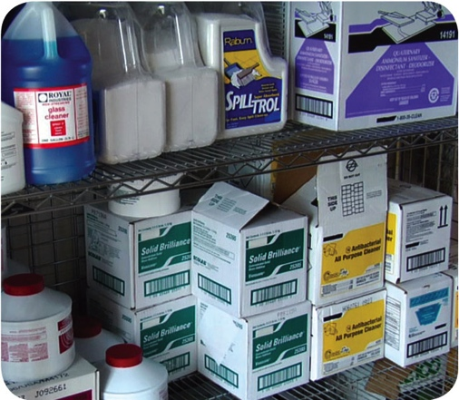
Chemical Contaminants
Prevention:
Only use chemicals approved for use in foodservice operations
Purchase chemicals from approved, reputable suppliers
Store chemicals away from prep areas, food-storage areas, and service areas.
Chemicals must be separated from food and food-contact surfaces by spacing and partitioning
Chemicals must NEVER be stored above food or food-contact surfaces
Use chemicals for their intended use and follow manufacturer’s directions
2-35

Slide 61
Chemical Contaminants
Prevention:
Only handle food with equipment and utensils approved for foodservice use
Make sure the manufacturer’s labels on original chemical containers are readable
Keep MSDS current, and make sure they are accessible to staff at all times
Follow the manufacturer’s directions and local regulatory requirements when throwing out chemicals
2-36

Slide 62
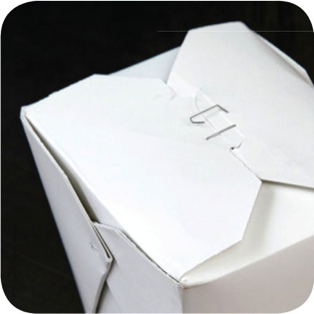
Physical Contaminants
Sources:
Common objects that get into food
Metal shavings from cans
Wood
Fingernails
Staples
Bandages
Glass
Jewelry
Dirt
Naturally occurring objects such as fruit pits and bones
2-37
Notes:
Instructor Notes
Food can become contaminated when objects get into it. It can also happen when natural objects are left in food, like bones in a fish fillet.

Slide 63
Physical Contaminants
Symptoms:
Mild to fatal injuries are possible
Cuts, dental damage, and choking
Bleeding and pain
Prevention:
Purchase food from approved, reputable suppliers
Closely inspect food received
Take steps to prevent physical contamination, including practicing good personal hygiene
2-38

Slide 64
Deliberate Contamination of Food
Groups who may attempt to contaminate food:
Terrorists or activists
Disgruntled current or former staff
Vendors
Competitors
FDA defense tool:
A.L.E.R.T.
2-39
Notes:
Instructor Notes
So far, you have learned about methods to prevent the accidental contamination of food. But you also must take steps to stop people who are actually trying to contaminate it. This may include the groups listed on the slide.
These people may try to tamper with your food using biological, chemical, or physical contaminants. They may even use radioactive materials. Attacks might occur anywhere in the food supply chain. But they are usually focused on a specific food item, process, or business.
The best way to protect food is to make it as difficult as possible for someone to tamper with it. For this reason, a food defense program should deal with the points in your operation where food is at risk.
The FDA has created a tool that can be used to develop a food defense program. It is based on the acronym A.L.E.R.T. It can be used to help you identify the points in your operation where food is at risk.

Slide 65
Deliberate Contamination of Food
Assure Make sure products received are from safe sources
Look Monitor the security of products in the facility
Employees Know who is in your facility
Reports Keep information related to food defense accessible
Threat Develop a plan for responding to suspicious activity or a threat to the operation
2-40
Notes:
Instructor Notes
Assure Make sure that products you receive are from safe sources. Supervise product deliveries. Use approved suppliers who practice food defense. Request that delivery vehicles are locked or sealed.
Look Monitor the security of products in the facility. Limit access to prep and storage areas. Locking storage areas is one way to do this. Create a system for handling damaged products. Store chemicals in a secure location. Train staff to spot food defense threats.
Employees Know who is in your facility. Limit access to prep and storage areas. Identify all visitors, and verify credentials. Conduct background checks on staff.
Reports Keep information related to food defense accessible: receiving logs, office files and documents, staff files, and random food defense self-inspections.
Threat Identify what you will do and who you will contact if there is suspicious activity or a threat at your operation. Hold any product you suspect to be contaminated. Contact your regulatory authority immediately. Maintain an emergency contact list.

Slide 66
Responding to a Foodborne-Illness Outbreak
Gather information
Notify authorities
Segregate product
Document information
Identify staff
Cooperate with authorities
Review procedures
2-41
Notes:
Instructor Notes
Here are some things you should consider when responding to an outbreak. These will be discussed in the next several slides.

Slide 67
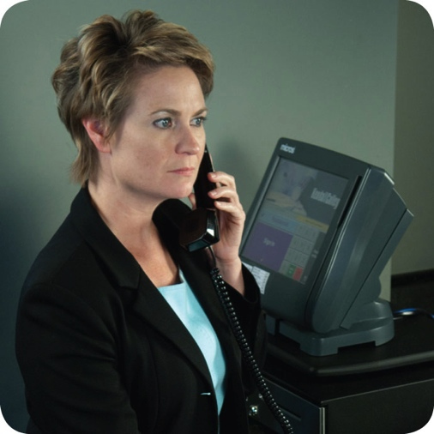
Responding to a Foodborne-Illness Outbreak
Gather information
Ask the person for general contact information
Ask the person to identify the food eaten
Ask for a description of symptoms
Ask when the person first got sick
Notify authorities
Contact the local regulatory authority if an outbreak is suspected
2-42
Notes:
Instructor Notes
Ask the person making the complaint for general contact information and to identify the food that was eaten. Also ask for a description of symptoms and when the person first got sick.
Contact the local regulatory authority if you suspect an outbreak.

Slide 68
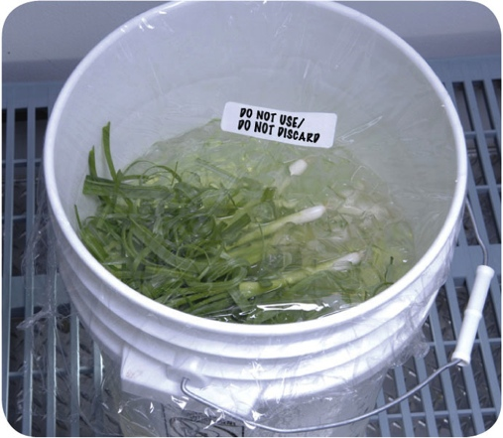
Responding to a Foodborne-Illness Outbreak
Segregate product
Set the suspected product aside if any remains
Include a label with “Do Not Use” and “Do Not Discard” on it
Document the information
Log information about suspected product
Include a product description, product date, lot number, sell-by date, and pack size
2-43
Notes:
Instructor Notes
Set the suspected product aside if any remains. Include a label with Do Not Use and Do Not Discard on it, as shown in the photo on the slide.
Log information about the suspected product. This might include a product description, production date, and lot number. The sell-by date and pack size should also be recorded.

Slide 69
Responding to a Foodborne-Illness Outbreak
Identify staff
Keep a list of food handlers scheduled at time of incident
Interview staff immediately
Cooperate with authorities
Provide appropriate documentation
Review procedures
Determine if standards are being met
Identify if standards are not working
2-44
Notes:
Instructor Notes
Maintain a list of food handlers scheduled at the time of the suspected contamination. These staff members may be subject to an interview and sampling by investigators. They should also be interviewed immediately by management about their health status.
Cooperate with regulatory authorities in the investigation. Provide appropriate documentation. You may be asked to provide temperature logs, HACCP documents, staff files, etc.
Review food-handling procedures to identify if standards are not being met or procedures are not working.

Slide 70
Food Allergens
Food allergen:
A protein in a food or ingredient some people are sensitive to
These proteins occur naturally
When an enough of an allergen is eaten, an allergic reaction can occur
2-45

Slide 71
Food Allergens
Allergy symptoms:
Nausea
Wheezing or shortness of breath
Hives or itchy rashes
Swelling in various parts of the body, including the face, eyes, hands, or feet
Vomiting and/or diarrhea
Abdominal pain
Allergic reactions:
Symptoms can become serious quickly
A severe reaction, called anaphylaxis, can lead to death
2-46
Notes:
Instructor Notes
Depending on the person, an allergic reaction can happen just after the food is eaten or several hours later. This reaction could include some or all of the symptoms identified in the slide.
Initially symptoms may be mild, but they can become serious quickly. In severe cases, anaphylaxis—a severe allergic reaction that can lead to death—may result.
If a customer is having an allergic reaction to food, call the emergency number in your area.

Slide 72
Food Allergens
The Big Eight food allergens:
Milk
Eggs
Soy
Fish
Tree nuts, such as almonds, walnuts, and pecans
Peanuts
Crustacean shellfish, including lobster, shrimp, and crab
Wheat
2-47
Notes:
Instructor Notes
While more than 160 food items can cause allergic reactions, just eight of those account for 90 percent of all reactions in the United States. These eight food items are known as the Big Eight.
The slide shows the Big Eight food allergens.

Slide 73
Food Allergens
Know How To Read Food Labels
Check food labels for allergens
2-48
Notes:
Instructor Notes
Food labels on the products that you purchase are an important tool to identify allergens in the operation. Federal law requires manufactured products containing one or more of the Big Eight allergens to clearly identify them on the ingredient label.
The allergen may be included in the common name of the food, such as “buttermilk”, or it may be shown in parentheses after the ingredient. Often, allergens will be shown in a “contains” statement.

Slide 74
Prevent Allergic Reactions
Service staff:
Describe menu items to guests, identify any allergens in the item
Suggest menu items without the allergen
Clearly identify the guest’s order for kitchen and service staff
Deliver food separately to prevent cross-contact
2-49
Notes:
Instructor Notes
Your staff should be able to tell customers about menu items that contain potential allergens. At minimum, have one person available per shift to answer customers’ questions about menu items. When customers say they have a food allergy, your staff should take it seriously.
Tell customers how the item is prepared. Sauces, marinades, and garnishes often contain allergens. For example, peanut butter is sometimes used as a thickener in sauces or marinades. This information is critical to a customer with a peanut allergy.
Tell customers if the food they are allergic to is in the menu item. Identify any “secret” ingredients. For example, your operation may have a house specialty that includes an allergen.
Suggest menu items that do not contain the food that the customer is allergic to.
Clearly mark or otherwise indicate the order for the guest with the identified food allergy. This is done to inform the kitchen staff of the guest’s food allergy.
Confirm the allergen special order with the kitchen staff when picking up the food. Make sure no garnishes or other items containing the allergen touch the plate. Food should be hand-delivered to guests with allergies. Delivering food separately from the other food delivered to a table will help prevent contact with food allergens.

Slide 75
Prevent Allergic Reactions
Kitchen staff:
Avoid cross-contact
Do NOT cook different types of food in the same fryer oil
Do NOT put food on surfaces that have touched allergens
2-50
Notes:
Instructor Notes
Staff must make sure that allergens are not transferred from food containing an allergen to the food served to the customer. This is called cross-contact.
Cooking different types of food in the same fryer oil can cause cross-contact. In the photo on the slide, shrimp allergens could be transferred to the chicken being fried in the same oil.
Putting food on surfaces that have touched allergens can cause cross-contact. For example, putting chocolate chip cookies on the same parchment paper that was used for peanut butter cookies can transfer some of the peanut allergen.

Slide 76
Prevent Allergic Reactions
Kitchen staff:
Avoid cross-contact
Check recipes and ingredient labels
Wash, rinse, and sanitize cookware, utensils, and equipment before preparing an allergen special order
Make sure the allergen doesn’t touch anything for customers with food allergies (food, beverages, utensils, etc.)
Wash your hands and change gloves before prepping food
Label food packaged on-site for retail use
2-51
Notes:
Instructor Notes
• Check recipes and ingredient labels to confirm that the allergen is not present.
• Wash, rinse, and sanitize cookware, utensils, and equipment before prepping food, as shown in the photo on the slide. This includes food-prep surfaces. Some operations use a separate set of cooking utensils just for allergen special orders.
• Make sure the allergen does not touch anything for customers with food allergies, including food, beverages, utensils, equipment, and gloves.
• Wash your hands and change gloves before prepping food.
• Use separate fryers and cooking oils when frying food for customers with food allergies.
• Label food packaged on-site for retail sale. Name all major allergens on the label and follow any additional labeling requirements.

Slide 78
The Safe Food Handler
Objectives:
Avoiding personal behaviors that can contaminate food
Washing and caring for hands
Dressing for work and handling work clothes
Limiting where staff can eat, drink, smoke, and chew gum or tobacco
Preventing staff who may be carrying pathogens from working with or around food, or from working in the operation
3-2
Notes:
Instructor Notes
Discuss the topic objectives with the class.

Slide 79
How Food Handlers Can Contaminate Food
Food handlers can contaminate food when they:
Have a foodborne illness
Have wounds that contain a pathogen
Sneeze or cough
Have contact with a person who is sick
Touch anything that may contaminate their hands and don’t wash them
Have symptoms such as diarrhea, vomiting, or jaundice—a yellowing of the eyes or skin
3-3
Notes:
Instructor Notes
With some illnesses, a person may infect others before showing any symptoms. For example, a person could spread hepatitis A for weeks before having any symptoms.
With other illnesses, a person may infect others for days or even months after symptoms are gone. Norovirus can be spread for days after symptoms have ended.
Some people carry pathogens and infect others without ever getting sick themselves. These people are called carriers. The bacteria Staphylococcus aureus is carried in the nose of 30 to 50 percent of healthy adults. About 20 to 35 percent of healthy adults carry it on their skin. Food handlers transfer this type of bacteria to food when they touch the infected areas of their bodies and then touch food without washing their hands.

Slide 80
How Food Handlers Can Contaminate Food
Actions that can contaminate food:
Scratching the scalp
Running fingers through hair
Wiping or touching the nose
Rubbing an ear
Touching a pimple or infected wound
Wearing a dirty uniform
Coughing or sneezing into the hand
Spitting in the operation
3-4
Notes:
Instructor Notes
People often do things that can spread pathogens without knowing it. To avoid causing a foodborne illness, food handlers must pay close attention to what they do with their hands and avoid the actions indicated in the slide.

Slide 81
Managing a Personal Hygiene Program
Managers must focus on the following:
Creating personal hygiene policies
Training food handlers on personal hygiene policies and retraining them regularly
Modeling correct behavior at all times
Supervising food safety practices
Revising personal hygiene policies when laws or science change
3-5
Notes:
Instructor Notes
Don’t underestimate your role in a personal hygiene program. You have many responsibilities to help make the program work. Some of these are highlighted in the slide.

Slide 82
Handwashing
How to wash hands (should take at least 20 seconds):
1. Wet hands and arms. Use running water as hot as you can comfortably stand. It should be at least 100°F(38°C).
2. Apply soap. Apply enough to build up a good lather.
3. Scrub hands and arms vigorously. Scrub them for 10 to 15 seconds. Clean under fingernails and between fingers.
4. Rinse hands and arms thoroughly. Use running warm water.
5. Dry hands and arms. Use a single-use paper towel or hand dryer. Consider using a paper towel to turn off the faucet and open the restroom door.
3-6
Notes:
Instructor Notes
Handwashing is the most important part of personal hygiene. It may seem like an obvious thing to do. Even so, many food handlers do not wash their hands the correct way or as often as they should.
You must train your food handlers to wash their hands, and then you must monitor them.

Slide 83
When to Wash Hands
Food handlers must wash their hands before they start work and after:
Using the restroom
Handling raw meat, poultry, and seafood (before and after)
Touching the hair, face, or body
Sneezing, coughing, or using a tissue
Eating, drinking, smoking, or chewing gum or tobacco
Handling chemicals that might affect food safety
3-7

Slide 84
When to Wash Hands
Food handlers must wash their hands after:
Taking out garbage
Clearing tables or busing dirty dishes
Touching clothing or aprons
Handling money
Leaving and returning to the kitchen/prep area.
Handling service animals or aquatic animals
Touching anything else that may contaminate hands
3-8

Slide 85
Hand Antiseptics
Hand antiseptics:
Liquids or gels used to lower the number of pathogens on skin
Must comply with the CFR and FDA standards
Should be used only after handwashing
Must NEVER be used in place of handwashing
Should be allowed to dry before touching food or equipment
3-9

Slide 86
Hand Care
Requirements for food handlers:
Keep fingernails short and clean
Do NOT wear false nails
Do NOT wear nail polish
3-10
Notes:
Instructor Notes
Long fingernails may be hard to keep clean and can rip gloves. They can also chip and become physical contaminants.
Fingernails should be kept trimmed and filed. This will allow nails to be cleaned easily. Ragged nails can be hard to keep clean. They may also hold pathogens and break off—becoming physical contaminants.
Do not wear false fingernails. They can be hard to keep clean. False fingernails also can break off into food. Some local regulatory authorities allow false nails if single-use gloves are worn.
Do not wear nail polish. It can disguise dirt under nails and may flake off into food. Some regulatory authorities allow polished nails if single-use gloves are worn.

Slide 87
Infected Wounds or Cuts
Infected wounds or cuts:
Contain pus
Must be covered to prevent pathogens from contaminating food and food-contact surfaces
How a wound is covered depends on where it is located:
Cover wounds on the hand or wrist with an impermeable cover, (e.g. bandage or finger cot) and then a single-use glove
Cover wounds on the arm with an impermeable cover, such as a bandage
Cover wounds on other parts of the body with a dry, tight-fitting bandage
3-11

Slide 88
Single-Use Gloves
Single-use gloves:
Should be used when handling ready-to-eat food
Except when washing produce
Except when handling ready-to-eat ingredients for a dish that will be cooked to the correct temperature
Must NEVER be used in place of handwashing
Must NEVER be washed and reused
Must fit correctly
3-12
Notes:
Instructor Notes
Single-use gloves can help keep food safe by creating a barrier between hands and food. Gloves should be worn when handling ready-to-eat food. The exceptions include when washing produce, or when handling ready-to-eat ingredients for a dish that will be cooked to the correct internal temperature.
Make sure you provide different glove sizes. Gloves that are too big will not stay on. Those that are too small will tear or rip easily.
Some food handlers and customers may be sensitive to latex. Consider providing gloves made from other materials.

Slide 89
Single-Use Gloves
How to use gloves:
Wash hands before putting gloves on when starting a new task
Select the correct glove size
Hold gloves by the edge when putting them on
Once gloves are on, check for rips or tears
NEVER blow into gloves
NEVER roll gloves to make them easier to put on
3-13
Notes:
Instructor Notes
Wash your hands before putting gloves on when starting a new task. You do not need to rewash your hands each time you change gloves as long as you are performing the same task, and your hands have not become contaminated.
Avoid contaminating gloves when putting them on.

Slide 90
Single-Use Gloves
When to change gloves:
As soon as they become dirty or torn
Before beginning a different task
After an interruption, such as taking a phone call
After handling raw meat, seafood, or poultry and before handling ready-to-eat food
3-14

Slide 91
Bare-Hand Contact with Ready-to-Eat Food
Bare-hand contact with ready-to-eat food must be avoided unless:
The food is an ingredient in a dish that does not contain raw meat, seafood, or poultry
The dish will be cooked to at least 145˚F (63˚C)
The food is an ingredient in a dish containing raw meat, seafood, or poultry
The dish will be cooked to the required minimum internal temperature of the raw item(s)
NEVER handle ready-to-eat food with bare hands when you primarily serve a high-risk population
3-15
Notes:
Instructor Notes
Food can become contaminated when it has been handled with bare hands. This is especially true when hands have not been washed correctly or have infected cuts or wounds. For this reason, do not handle ready-to-eat food with bare hands.
There are times when it may be acceptable to handle ready-to-eat food with bare hands. This is true in the situations identified in the slide.
Never handle ready-to-eat food with bare hands if you primarily serve a high-risk population.
Some regulatory authorities allow bare-hand contact with ready-to-eat food. If your jurisdiction allows this, you must have specific policies in place about staff health. You must also train staff in handwashing and personal hygiene practices.

Slide 92
Work Attire
Food handlers must:
Wear a clean hat or other hair restraint
Wear clean clothing daily
Remove aprons when leaving food-preparation areas
Remove jewelry from hands and arms before prepping food or when working around prep areas
3-16
Notes:
Instructor Notes
Do not wear hair accessories that could become physical contaminants. Hair restraints should be limited to items that keep hands out of hair, and hair out of food. Food handlers with facial hair should wear a beard restraint.
False eyelashes can become physical contaminants and should not be worn.
If possible, food handlers should change into work clothes at work. Dirty clothing stored in the operation must be kept away from food and prep areas. You can do this by placing them in nonabsorbent containers or washable laundry bags. This includes dirty aprons, chef coats, and uniforms.
Never wipe your hands on aprons.
Food handlers cannot wear jewelry when prepping food or when working around prep areas. That includes rings (except for a plain band), bracelets (including medical bracelets), and watches. Companies may also require food handlers to remove other types of jewelry. This may include earrings, necklaces, and facial jewelry. Servers may wear jewelry if allowed by company policy.

Slide 93
Eating, Drinking, Smoking, and Chewing Gum or Tobacco
Food handlers must not:
Eat, drink, smoke, or chew gum or tobacco
When:
Prepping or serving food
Working in prep areas
Working in areas used to clean utensils and equipment
3-17
Notes:
Instructor Notes
Small droplets of saliva can contain thousands of pathogens. In the process of eating, drinking, smoking, or chewing gum or tobacco, saliva can be transferred to hands or directly to food being handled. That’s why food handlers must not eat, drink, smoke, or chew gum or tobacco when performing the tasks indicated in the slide.
Some regulatory authorities allow food handlers to drink from a covered container while in prep and dishwashing areas.

Slide 94
Handling Staff Illnesses
If:
The food handler has a sore throat with a fever.
Then:
Restrict the food handler from working with or around food
Exclude the food handler from the operation if you primarily serve a high-risk population
A written release from a medical practitioner is required before returning to work
3-18
Notes:
Instructor Notes
You must encourage your staff to report any health problems before they come to work. This includes newly hired staff who haven’t started working yet.
Staff should also let you know immediately if they get sick while working. Your regulatory authority may ask you to prove you have made staff aware of this policy.
When food handlers are sick, you may need to restrict them from working with or around food. Sometimes, you may need to exclude them from working in the operation.

Slide 95
Handling Staff Illnesses
If:
The food handler has at least one of these symptoms.
Vomiting
Diarrhea
Then:
Exclude the food handler from the operation
Before returning to work, food handlers who vomited or had diarrhea must meet one of these requirements
Have had no symptoms for at least 24 hours
Have a written release from a medical practitioner
3-19

Slide 96
Handling Staff Illnesses
If:
The food handler has jaundice.
Then:
Report the food handler to the regulatory authority
Exclude food handlers from the operation if they have had jaundice for 7 days or less
Food handlers must have a written release from a medical practitioner and approval from the regulatory authority before returning to work
3-20

Slide 97
Handling Staff Illnesses
If:
The food handler is vomiting or has diarrhea and has been diagnosed with an illness caused by one of these pathogens.
Norovirus
Shigella spp.
Nontyphoidal Salmonella
Shiga toxin-producing E. coli
Then:
Exclude the food handler from the operation
Work with the food handler’s medical practitioner and/or the local regulatory authority to decide when the person can go back to work
3-21
Notes:
Instructor Notes
Some food handlers diagnosed with these foodborne illnesses may or may not experience the usual symptoms, or their symptoms may be over. It is important to work with the local regulatory authority to determine whether the food handler must be excluded from the establishment or restricted from working with or around food, and when the exclusion can be removed.
Instructor Notes
Some food handlers diagnosed with these foodborne illnesses may not experience the usual signs or their symptoms may be over. Work with the local regulatory authority to determine whether the food handler must be excluded from the operation or restricted from working with or around food, and when the exclusion or restriction can be removed.
Remember these are only guidelines, working with your regulatory authority will help you determine the best course of action.

Slide 98
Handling Staff Illnesses
If:
The food handler has been diagnosed with an illness caused by one of these pathogens.
Hepatitis A
Salmonella Typhi
Then:
Exclude the food handler from the operation
Work with the food handler’s medical practitioner and/or the local regulatory authority to decide when the person can go back to work
3-22
Notes:
Instructor Notes
Whether or not a food handler has symptoms, those diagnosed with a disease caused by these pathogens must be excluded from the operation. Work with the local regulatory authority to determine when the exclusion can be removed.
Remember these are only guidelines, working with your regulatory authority will help you determine the best course of action.

